Slide 1

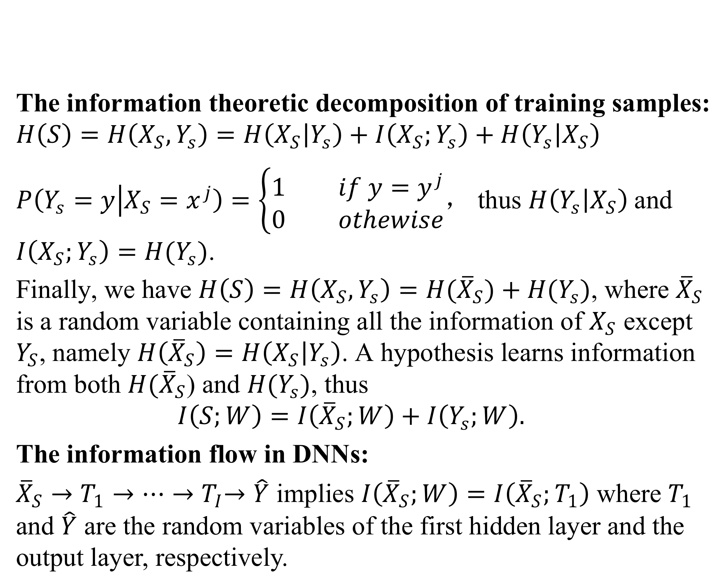
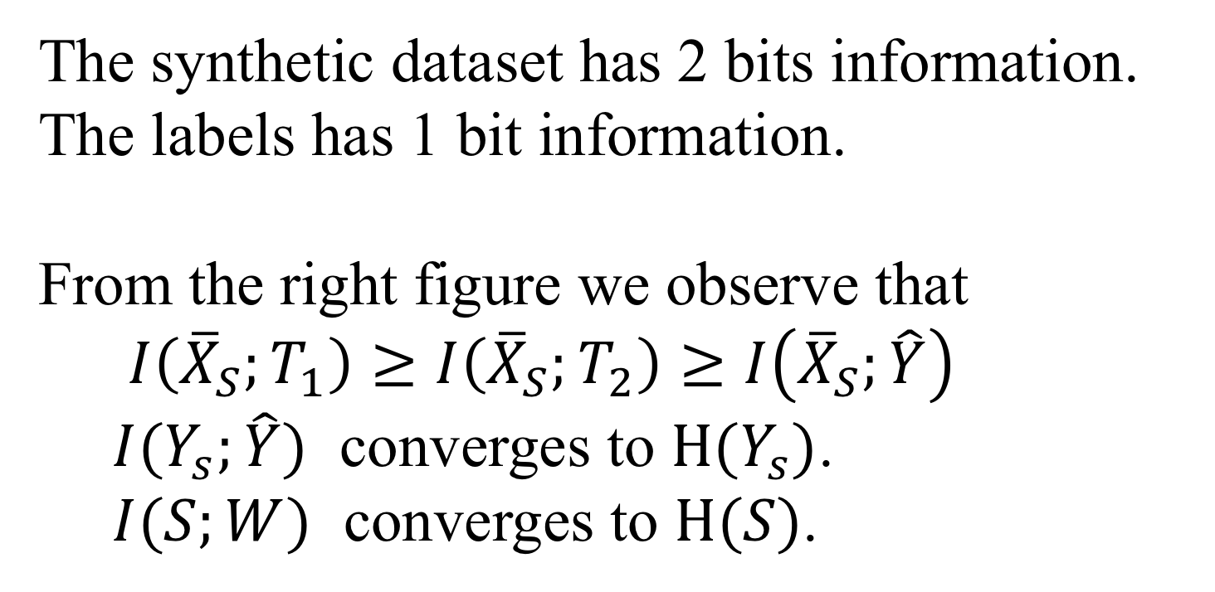

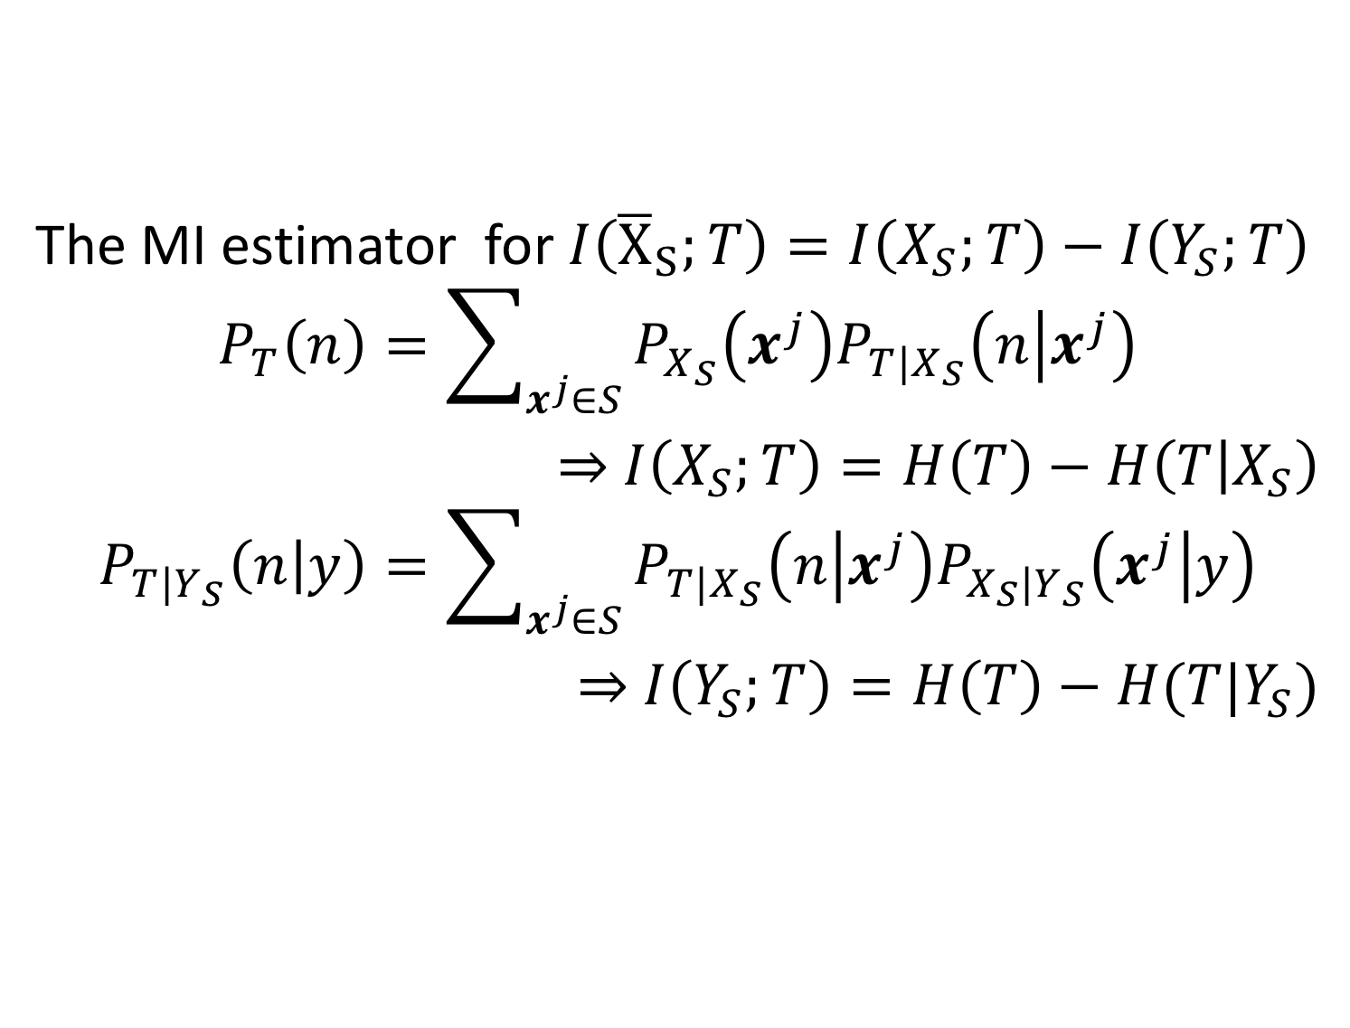
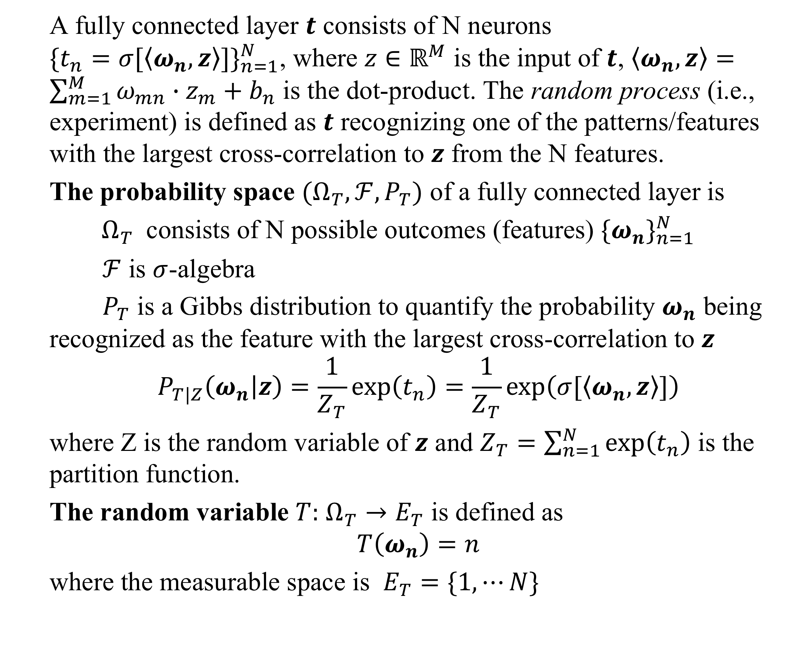
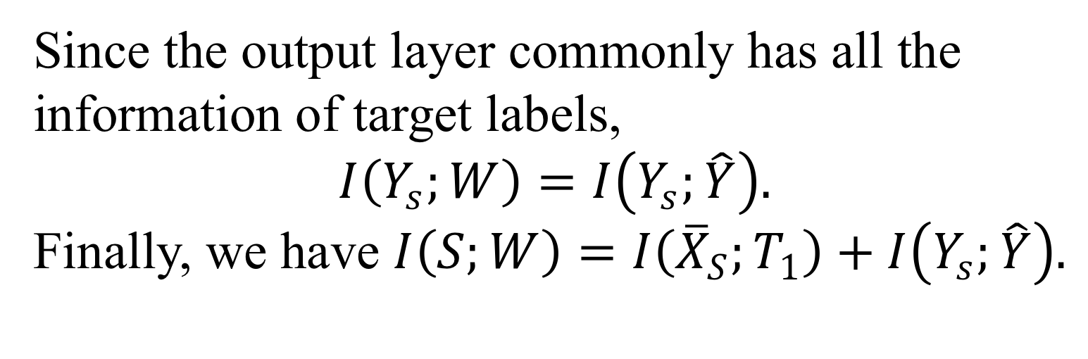
A Probabilistic Representation of DNNs: Bridging Mutual Information and Generalization
Xinjie Lan and Kenneth E. Barner
Electrical and Computer Engineering Department, University of Delaware, Newark DE
1. Introduction
A fully connected layer $t$ consists of N neurons ${\{t_{n}=σ[\left\langle ω_{n},z\right\rangle ]\}}_{n=1}^{N}$, where $z∈ℝ^{M}$ is the input of $t$, $\left\langle ω_{n},z\right\rangle =\sum_{m=1}^{M}{ω_{mn}∙z_{m}+b_{n}}$ is the dot-product. The random process (i.e., experiment) is defined as $t$ recognizing one of the patterns/features with the largest cross-correlation to $z$ from the N features.
The probability space $(Ω_{T},ℱ,P_{T})$ of a fully connected layer is
$Ω_{T}$ consists of N possible outcomes (features) ${\{ω_{n}\}}_{n=1}^{N}$
$ℱ$ is $σ$-algebra
$P_{T}$ is a Gibbs distribution to quantify the probability $ω_{n}$ being recognized as the feature with the largest cross-correlation to $z$
$$P_{T|Z}\left(ω_{n} | z\right)=\frac{1}{Z_{T}}\exp\left(t_{n}\right)=\frac{1}{Z_{T}}\exp\left(σ[\left\langle ω_{n},z\right\rangle ]\right)$$
where Z is the random variable of $z$ and $Z_{T}=\sum_{n=1}^{N}{\exp\left(t_{n}\right)}$ is the partition function.
The random variable $T:$ $Ω_{T}→E_{T}$ is defined as
$$T\left(ω_{n}\right)=n$$
where the measurable space is $E_{T}=\{1,⋯N\}$
Generalization is fundamental problem of deep learning. Recently, Mutual Information (MI) has attracted interesting in bounding the generalization error of a learning algorithm.
Preliminaries:
$μ=P(X,Y)$ is an unknown data generating distribution, where X and Y are random variables of data and labels, respectively.
$S={\{(x^{j},y^{j})\}}_{j=1}^{n}∈{(𝒳×𝒴)}^{J}$ is composed of J i.i.d. samples generated from $S\sim μ^{⨂J}$, where $⨂$ is the Hadamard product. $X_{S}$and $Y_{s}$ are random variables of data samples and label samples, respectively.
$𝒲=\{w:𝒳→𝒴\}$ defines a set of hypothesis and $ℓ:𝒲×𝒳×𝒴→R^{+}$ is a loss function
The population risk $L_{μ}\left(w\right)$ and the empirical risk $L_{S}\left(w\right)$ are defined as
$$L_{μ}\left(w\right)≜\underset{\left(x,y\right)∈μ}{E}{ℓ\left(w,x,y\right)}, L_{S}\left(w\right)≜\frac{1}{J}{\sum_{j=1}^{J}{ℓ(w,x^{j},y^{j})}}$$
In the information theoretic framework proposed by Russo and Zou [1], a learning algorithm is characterized by $P_{W|S}$, the expected generalization error is defined as
$$gen(μ,P_{W|S})≜E[L_{μ}\left(w\right)−L_{S}\left(w\right)]$$
The expectation is taken with respect to $μ^{⨂J}⨂P_{W|S}$.
Theorem: assuming the loss function $ℓ$ being $σ$-subgaussian, Xu and Raginsky, 2017 derive the mutual information bound as
$$\left|gen(μ,P_{W|S})\right|≤\sqrt{\frac{2σ^{2}}{J}I(S;W)}$$
The MI bound is consistent with the Occam’s razor (Blumer et al., 1987), i.e., a simpler hypothesis commonly learn less information from training samples, thus it would generalize better.
Motivation: the accurate MI estimation for $I(S;W)$ is intractable, thus most previous works have to relax the bound, which loosens the MI bound and weakens the information theoretic explanation.
We attempt to derive an accurate MI bound on the generalization error.
The MI estimator for $I\left({\overline{X}}_{S};T\right)=I\left(X_{S};T\right)−I\left(Y_{S};T\right)$
$$P_{T}\left(n\right)=\sum_{x^{j}∈S}{{P_{X_{S}}\left(x^{j}\right)P}_{T|X_{S}}\left(n | x^{j}\right)}$$
$⇒$ $I\left(X_{S};T\right)=H\left(T\right)−H\left(T | X_{S}\right)$
$$P_{T|Y_{S}}\left(n | y\right)=\sum_{x^{j}∈S}{P_{T|X_{S}}\left(n | x^{j}\right)P_{X_{S}|Y_{S}}\left(x^{j} | y\right)}$$
$⇒$ $I\left(Y_{S};T\right)=H\left(T\right)−H(T|Y_{S})$
3. Experiments
The synthetic dataset has 2 bits information.
The labels has 1 bit information.
From the right figure we observe that
$I\left({\overline{X}}_{S};T_{1}\right)≥I\left({\overline{X}}_{S};T_{2}\right)≥I\left({\overline{X}}_{S};\hat{Y}\right)$
$I(Y_{s};\hat{Y})$ converges to $H(Y_{s})$.
$I(S;W)$ converges to $H(S)$.
2. A Probabilistic Explanation for DNNs
The information theoretic decomposition of training samples:
$$H\left(S\right)=H\left(X_{S},Y_{s}\right)=H\left(X_{S} | Y_{s}\right)+I\left(X_{S};Y_{s}\right)+H\left(Y_{s} | X_{S}\right)$$
$P\left(Y_{s}=y | X_{S}=x^{j}\right)=\left\{\begin{aligned}1 if y=y^{j} \\ 0 othewise\end{aligned}\right.$， thus $H\left(Y_{s} | X_{S}\right)$and $I\left(X_{S};Y_{s}\right)=H(Y_{s})$.
Finally, we have $H\left(S\right)=H\left(X_{S},Y_{s}\right)=H({\overline{X}}_{S})+H(Y_{s})$, where ${\overline{X}}_{S}$ is a random variable containing all the information of $X_{S}$ except $Y_{S}$, namely $H\left({\overline{X}}_{S}\right)=H\left(X_{S} | Y_{s}\right)$. A hypothesis learns information from both $H{(\overline{X}}_{S}$) and $H(Y_{s})$, thus
$$I\left(S;W\right)=I\left({\overline{X}}_{S};W\right)+I\left(Y_{s};W\right).$$
The information flow in DNNs:
${\overline{X}}_{S}→T_{1}→⋯{→T}_{I}→\hat{Y}$ implies $I\left({\overline{X}}_{S};W\right)=I\left({\overline{X}}_{S};T_{1}\right)$ where $T_{1}$ and $\hat{Y}$ are the random variables of the first hidden layer and the output layer, respectively.
Since the output layer commonly has all the information of target labels,
$$I\left(Y_{s};W\right)=I\left(Y_{s};\hat{Y}\right).$$
Finally, we have $I\left(S;W\right)=I\left({\overline{X}}_{S};T_{1}\right)+I\left(Y_{s};\hat{Y}\right).$
4. Conclusion
The probabilistic representation of DNNs enables us to accurately estimate $I\left(S;W\right)=I\left({\overline{X}}_{S};T_{1}\right)+I(Y_{s};\hat{Y})$.
Directly estimating $I\left(S;W\right)$ derives the much tighter generalization bound than the existing relaxations.
This material is based upon work supported by the National Science Foundation under Grant No. 1319598

